Slide 1
Middle earth automates
Brian Watson Cristiane Karasek Wasielewski Gregory feijo Wagner ROSSI

Slide 2
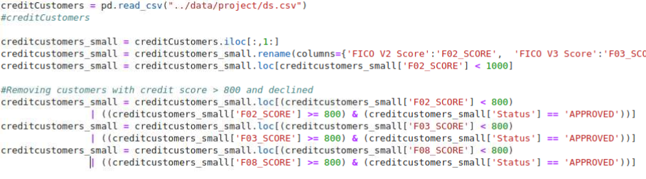

Problem
Predict users credit decision based on FICO scores
Data prep

Slide 3
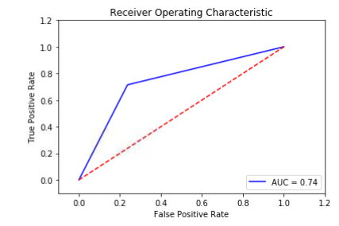
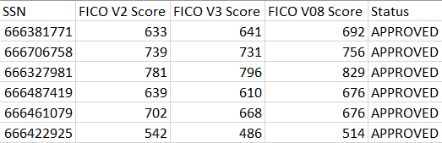
Results – Multi logistic regression
Results – svm

Slide 4
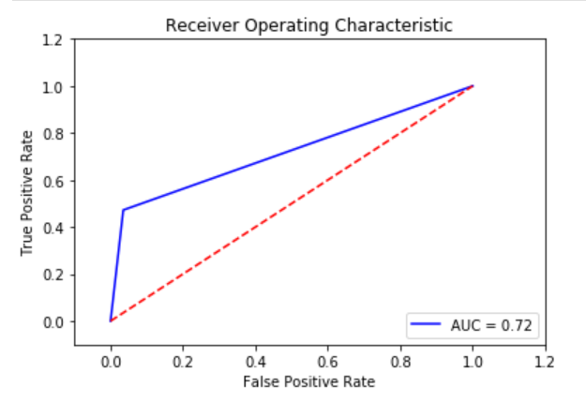
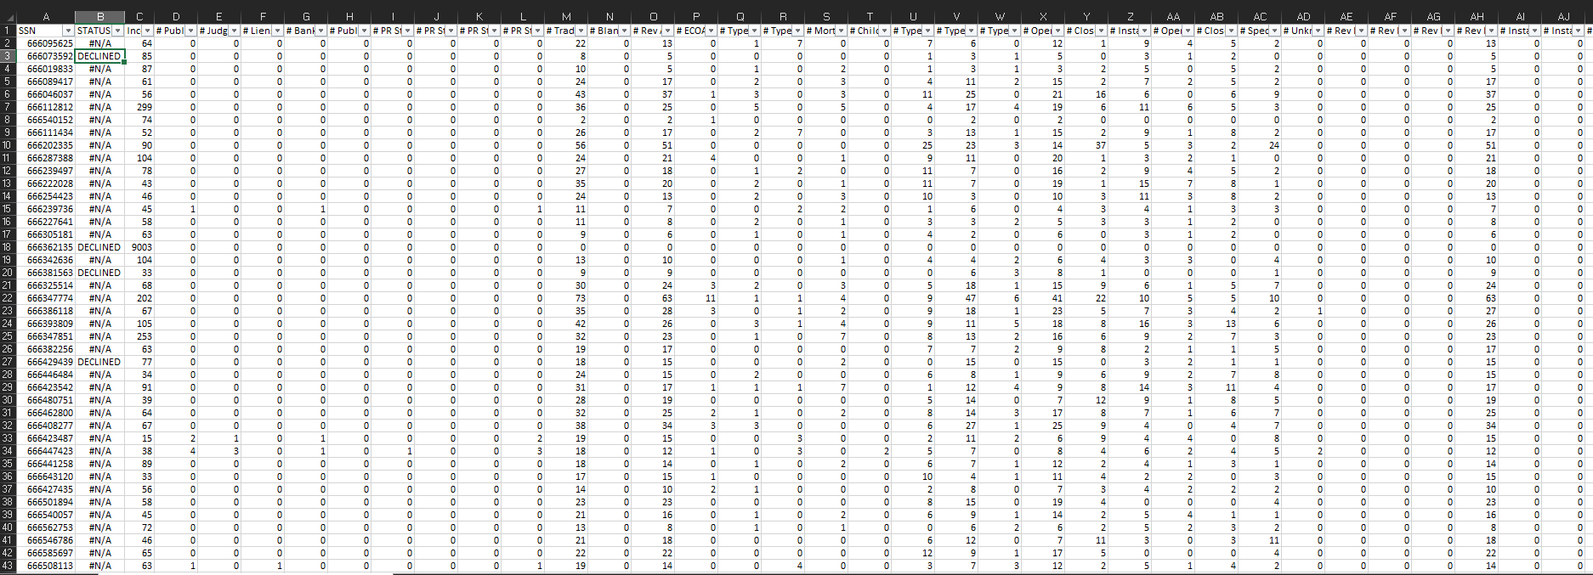
Results – Multi logistic regression

